Slide 1

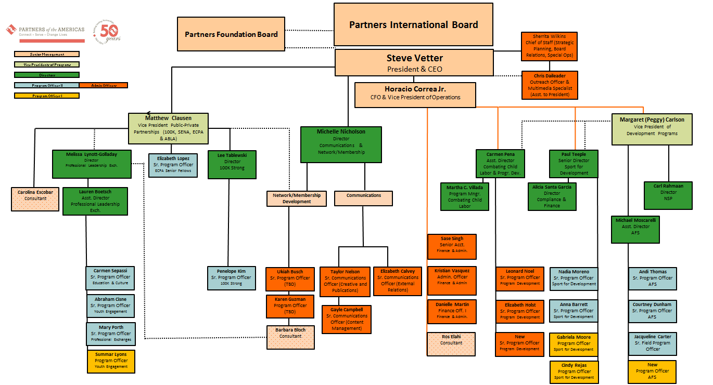
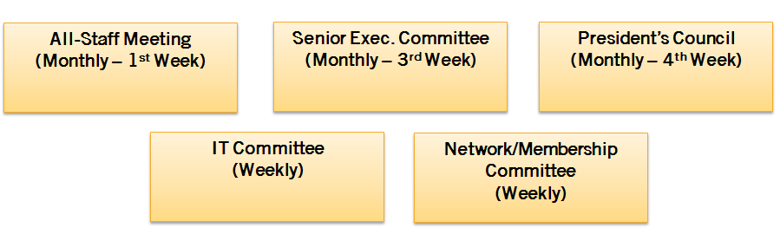
Team of Teams
NEW 2015 Org Chart
Strategic Leadership Committees

Slide 2
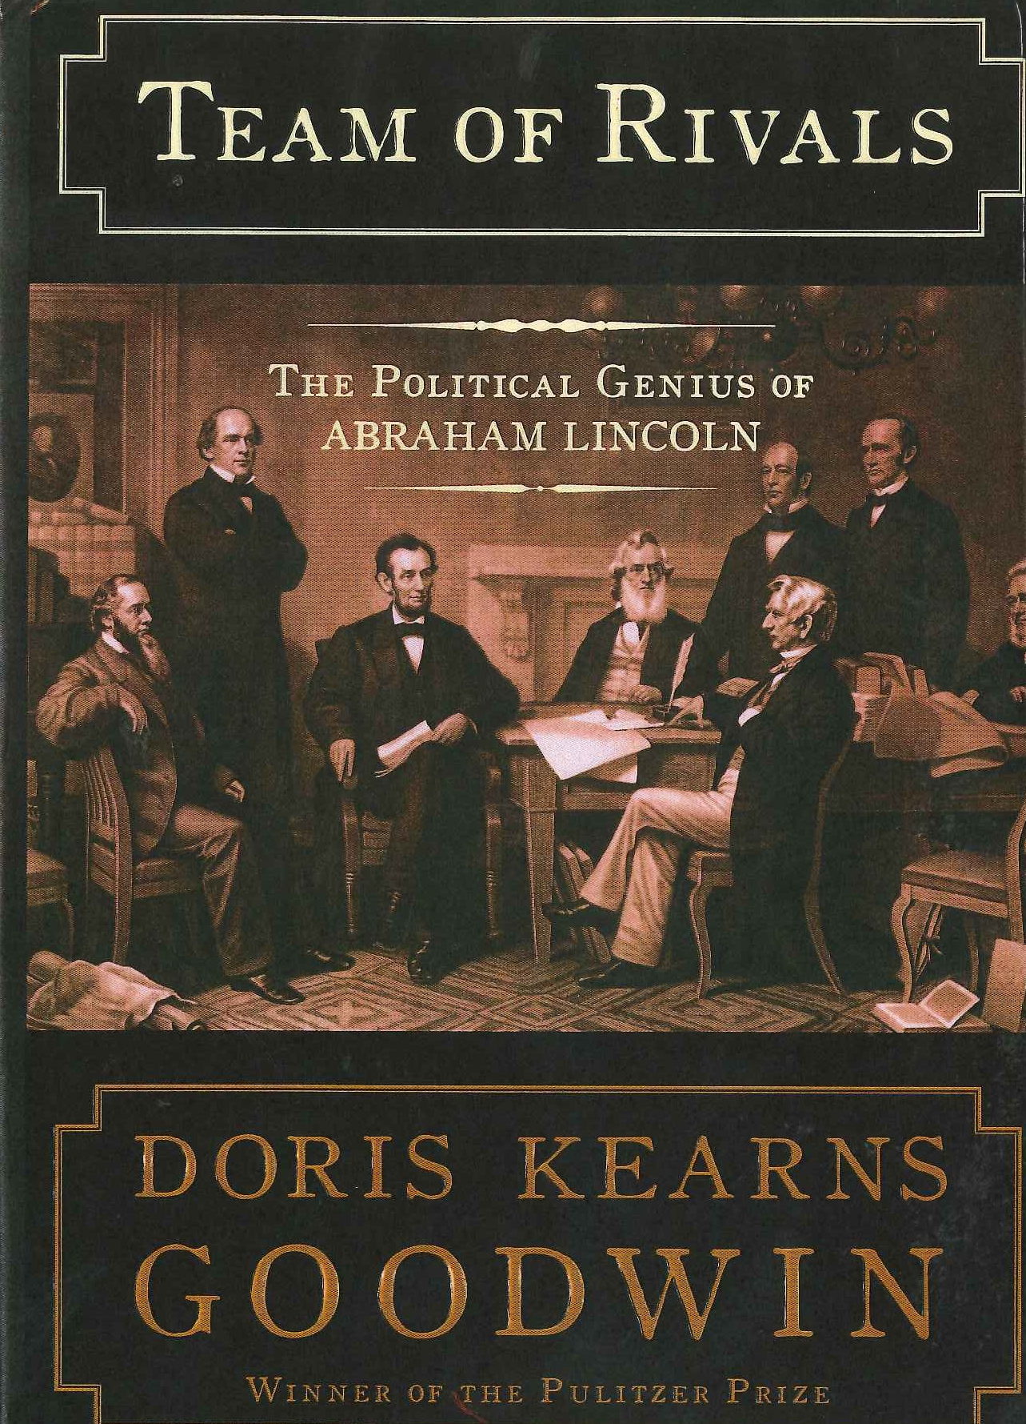
Team of Teams Strategic Leadership Committees

Slide 3
"It was a perfect and tragic case study
of the consequences of
information Silos and internal distrust” -GM Cobalt

Slide 4
“The collective intelligence of groups and communities has little to do with the intelligence of their individual members
and much more to do with the connections between them.”
-Sandy Pentland, MIT Professor

Slide 5
Idea Flow
According to Pentland, the two major determinants of
idea flow are:
Engagement within a small group, like a team, department, or neighborhood
Exploration or frequent contact with other units. In other words, a Team of Teams.

Slide 6
Value of Engagement
“Engagement was the central predictor of productivity, exceeding individual intelligence, personality, and skill.
The teams that had the highest levels of
internal engagement and external exploration had much higher levels of creative output."

Slide 7
“The speed and interdependence of our current environment means that what we cannot know has grown even faster than what we know.
Leaders must find a way to empower their teams to find a way"

Slide 8
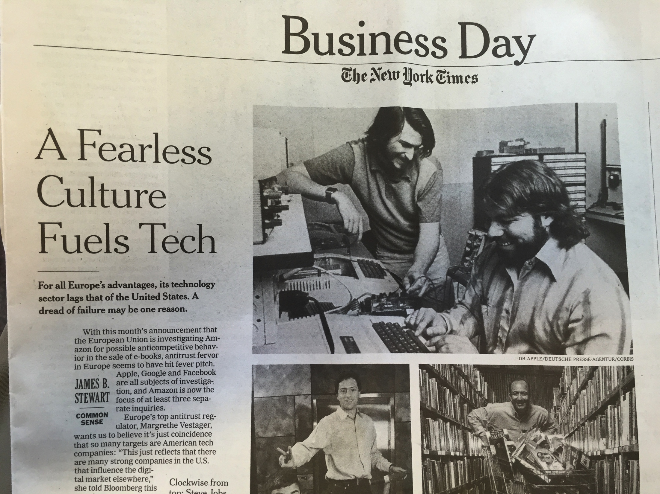

Slide 9
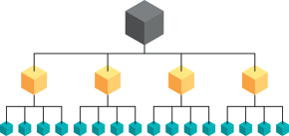
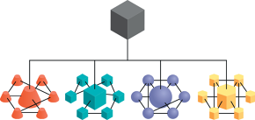
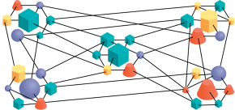
Command
Command Of Teams
Team of Teams

Slide 10
Director
Manager
Worker
Worker
Manager
Worker
Worker
Worker
Manager
Worker
Worker
Worker
Worker
Worker
Manager
Worker
Worker
COMMAND
In this traditional top-down structure, the connections that matter are the ones between workers and their managers.

Slide 11
COMMAND OF TEAMS
In this structure, adaptive small teams operate within a more rigid superstructure.

Slide 12
TEAM OF TEAMS (Our Goal)
The relationships among teams should resemble the closeness among individuals on those teams.

Slide 13

Senior Executive Committee
Peggy Carlson
(VP of Development Programs)
Matt Clausen
(VP Public-Private Partnerships)
Steve Vetter
(President and CEO)
Horacio Correa
(CFO)
Sherrita Wilkins
(Chief of Staff)
Michelle Nicholson (Director of Comm.)
Ukiah Busch
(Sr. Program Officer)
Liz Calvey
(Sr. Comm. Officer)
Horacio Correa
(CFO)
Peggy Carlson
(VP of Development Programs)
Sample Case for Team of Teams Approach
Steve Vetter
(President and CEO)
IT Committee

